Slide 1
Conflict Resolution or Don’t Waste a Crisis
2019 Annual Conference
Theresa Jennings
Jim Hawley

Slide 2
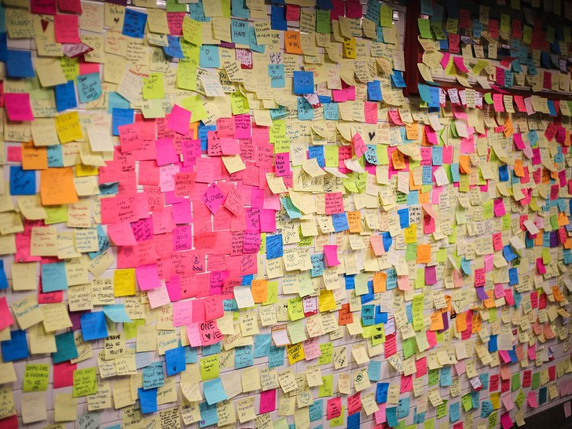
Place a sticky note on our wall – one conflict you are facing or dealing with in your ministry
Notes:
As everyone enters room give them a sticky note and have them write one area of conflict that exists in their ministry at the present time.

Slide 3

Introduction
Devotion and Prayer

Slide 4
Conflict Resolution Outline
Perceptions
Change Management
Trust
We do have a conflict
Myth vs Truth
Unhealthy aspects of conflict
What does conflict cause
What does the Bible say about resolving conflict
10 Principles of Peacemaking
Peacemaking resolution
Healthy responses to conflict
When Conflict does not Go Well
Questions and Comments
Wrap-up and conclusion

Slide 5

Do You Really Have a Conflict
Is it a perception difference?
Is it a change management issue?
Could it be a trust issue?
This Photo by Unknown Author is licensed under CC BY-NC-ND

Slide 6
Perception
“Perception is all there is.
There is no reality.
There is only perceived reality.”
Tom Peters
What do we mean by this?
Built to Last

Slide 7
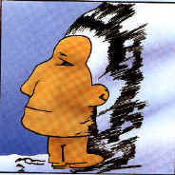
Perception Video & Exercise
Speed of Trust – Fishing video – everything is not as it seems
What do you see in this picture?

Slide 8


Slide 9

8 Step Change Management

Slide 10
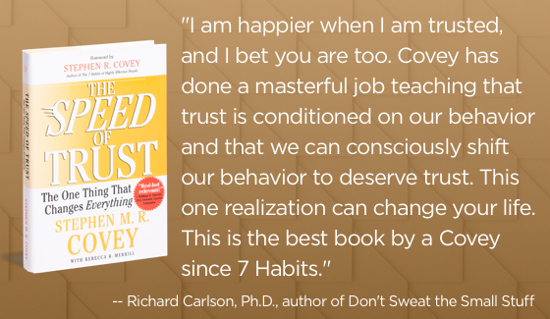
The 13 Behaviors of High-Trust Leaders –
Trust, it’s the One thing that Changes Everything
  Talk Straight
  Demonstrate Respect
  Create Transparency
  Right Wrongs
  Show Loyalty
  Deliver Results
  Get Better
  Confront Reality
  Clarify Expectations
  Practice Accountability
  Listen First
  Keep Commitments
  Extend Trust
These behaviors are common sense but not common practice
Hot Dog Man video

Slide 11
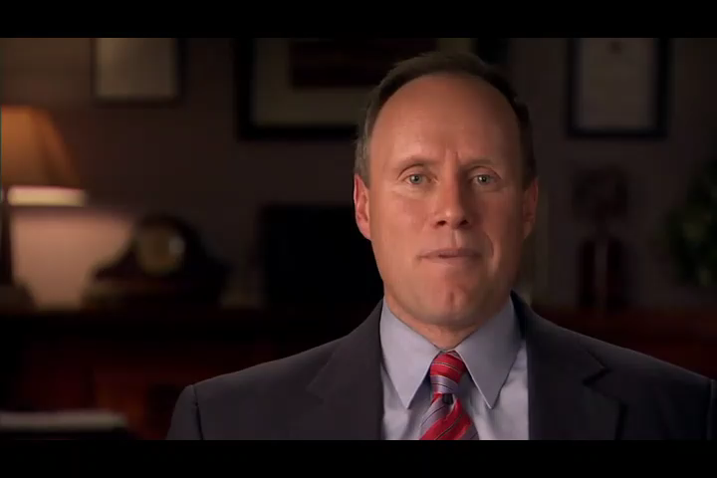

Slide 12
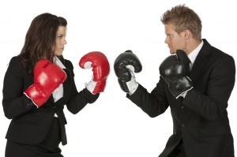
What is Conflict?
To come into collision or disagreement; be contradictory, at variance, or in opposition; clash:
To fight or contend; do battle.
A fight, battle, or struggle, esp. a prolonged struggle; strife.
Controversy; quarrel: conflicts between parties.
Discord of action, feeling, or effect; antagonism or opposition, as of interests or principles: a conflict of ideas.

Slide 13
Factors Associated with Ineffective Teamwork
The following five items are the highest causes of a department not being a team:
Lack of Trust: either toward a employee or a manager.
Fear of Conflict: Attempting to avoid a individual or a group of individuals while at work to prevent any issues from occurring.
Lack of commitment: Individual that is not dedicated to their job and/or lack of work ethic
Avoiding Accountability: A individual that feels others are responsible for making the decisions, if it goes bad, not their fault.
Lacks Attention to Detail: One that does not take pride in their work

Slide 14
Watch The Video And Ask Yourself…
What is conflict?
Is conflict good or bad?
Why does conflict happen or exist?
Can anything constructive happen because of conflict?
Is conflict avoidable?
Notes:
In just a minute we are going to show a video, and as you watch the video please ask yourselves the following questions.

Slide 15


Slide 16

Why Does Conflict Exist ?
Everyone is different
We have different lifestyles, perspectives, and personalities
We lack understanding
We have unclear or unfair expectations
We have poor communication skills
We live in a fallen world
Notes:
Conflict exist because humans are all different.
We are not the same.
We have different perspectives, different lifestyles and different personalities.
If you are in contact with people or in relationship with people, and google says the average person knows 600 people, there is the potential for problems within those relationships or conflict.
People have feelings, personal agendas, desires, and people have baggage –
and all these things effect how we interact with each other.

Slide 17
Myths vs. Truth
The Myths
The Truth
Conflict is bad
Conflict is an automatic
sign of bad communication skills
Conflict is a sign that you are a bad person
Conflict will resolve itself over time
Notes:
We will give them the myth, and let them give us the fact…

Slide 18

Unhealthy Responses To Conflict
Inability to recognize the importance of others
Angry, hurtful and resentful reaction
Withdrawal to punish
Expectation of bad outcome
Avoidance of Conflict

Slide 19
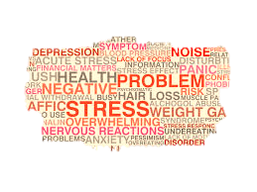
What Does Conflict Cause?
Strong emotions and reactions
Anger
Hurt feelings
Confusion
Discomfort around people
Damaged relationships
Disappointment
Health problems

Slide 20
Five Steps to Conflict Resolution
Include only those concerned.
Give a description of the problem that respects all involved.
Agree to engage in dialog.
Find a good time and place with no distractions.
Get someone to write down ideas.

Slide 21
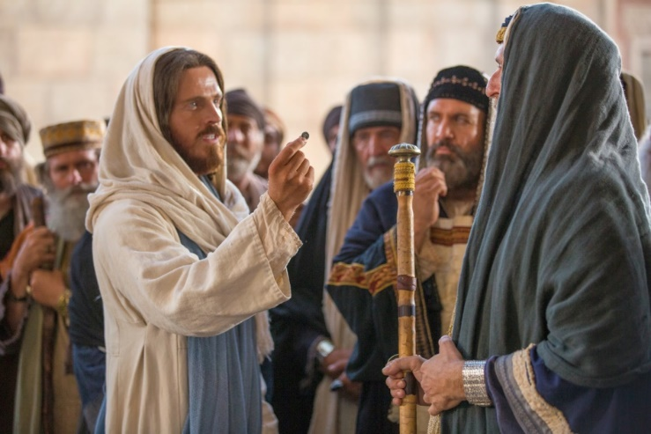

Conflict is contradictory to how we are to behave as Christians.
Conflict resolution is crucial within the Body of Christ, and forgiveness is essential.
The goal of conflict resolution is unity.
We should be of the same mind as the Lord when we approach conflict resolution.
Follow God’s word and act accordingly.
Jesus did not avoid conflict – he faced it head on

Slide 22

What Does The Bible Say About Conflict Resolution?

Slide 23
Listen to what the Owner’s Manual Says
Conflicts cannot be avoided--In the world you will have tribulation. But take heart; I have overcome the world. John 16:33
Conflicts are not necessarily bad—Iron sharpens iron, and one man sharpens another. Proverbs 27:17
Conflict provides an excellent opportunity to serve others—and if someone wants to sue you and take your tunic, let him have your cloak as well. If someone forces you to go one mile, go with him two miles. Matthew 5:40-41
Conflict calls for action toward peace—Let us pursue what makes for peace and for mutual building up. Romans 14:19
Conflicts can be opportunities to accomplish God’s purpose “Love your enemies, do good to those who hate you, bless those who curse you, pray for those who mistreat you…Be merciful, just as your Father is merciful. Luke6:27-36

Slide 24
10 principles of Peacemaking – Douglas Noll
  Peacemaking seeks long term sustainable solutions
  In peacemaking, truth telling and truth seeking are honored
  Peacemaking offers an opportunity to explore and discover
  Peacemaking techniques are creative, exploratory, and filled with risk
  Peacemaking is a refuge, a safe haven
  The peacemaker is charged with the secret duty of creating a refuge
  The peacemaker must create a place where people are able to approach, rather than freeze, flee or flight
  Peacemaking seeks to disenfranchise or confront in a process of controlled escalation
  Peacemaking involves risks, not the least of which is failure
  Peacemaking requires tremendous courage by those faced with difficult conflict

Slide 25
Peacemaker – Biblical Guide to Resolving Conflict
Short Course in Resolving Conflict
  Glorify God
  Get the log out of your own eye
  Gently restore
  Go and be reconciled

Slide 26
Healthy Responses To Conflict
Recognize and respond to important matters
Recognize the importance of relationship
Readiness to forgive
Ability to seek compromise
Ability to not punish
Belief that resolution can support both parties. WIN/WIN

Slide 27
When Conflict Does Not Go Well
Last Resort

Slide 28
When Conflict Does Not Go Well
Follow the process

Slide 29
Matthew 18
Dealing With Sin in the Church
¹⁵ “If your brother or sister^{[b]} sins,^{[c]} go and point out their fault, just between the two of you. If they listen to you, you have won them over. ¹⁶ But if they will not listen, take one or two others along, so that ‘every matter may be established by the testimony of two or three witnesses.’^{[d]} ¹⁷ If they still refuse to listen, tell it to the church; and if they refuse to listen even to the church, treat them as you would a pagan or a tax collector.
¹⁸ “Truly I tell you, whatever you bind on earth will be^{[e]} bound in heaven, and whatever you loose on earth will be^{[f]} loosed in heaven.
¹⁹ “Again, truly I tell you that if two of you on earth agree about anything they ask for, it will be done for them by my Father in heaven. ²⁰ For where two or three gather in my name, there am I with them.”

Slide 30

Seven Key Conflict Skills
Make the relationship the priority
Focus on the present
Pick your battles wisely
Be willing to forgive
Let it go
Don’t clam up
Be a great listener

Slide 31

Wrap - UP
Trust – 13 Behaviors?
Change Management?
Create Positive Conflict
Different Perceptions
Healthy Responses
Prayer covers everything – lets close in prayer

Slide 32

Questions/Comments

Slide 33
Finally, all of you should be of one mind. Sympathize with each other. Love each other as brothers and sisters. Be tenderhearted, and keep a humble attitude. Don’t repay evil for evil. Don’t retaliate with insults when people insult you. Instead, pay them back with a blessing. That is what God has called you to do, and he will grant you his blessing. For the Scriptures say,
“If you want to enjoy life and see many happy days, keep your tongue from speaking evil and your lips from telling lies. Turn away from evil and do good. Search for peace, and work to maintain it.”
1 Peter 3:8-11 (NLT)

